Slide 1
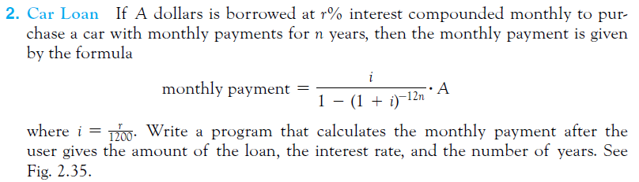
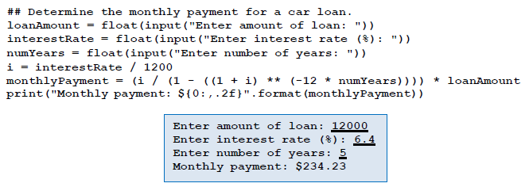

Slide 2
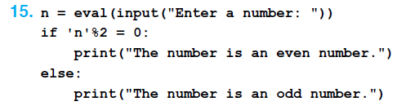



Slide 3
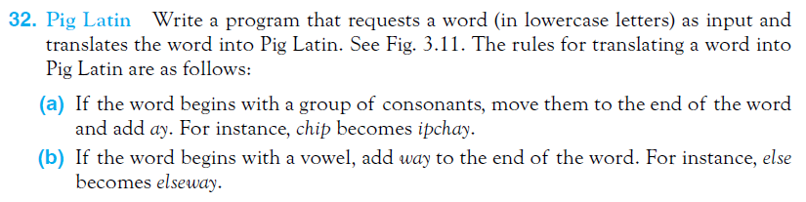
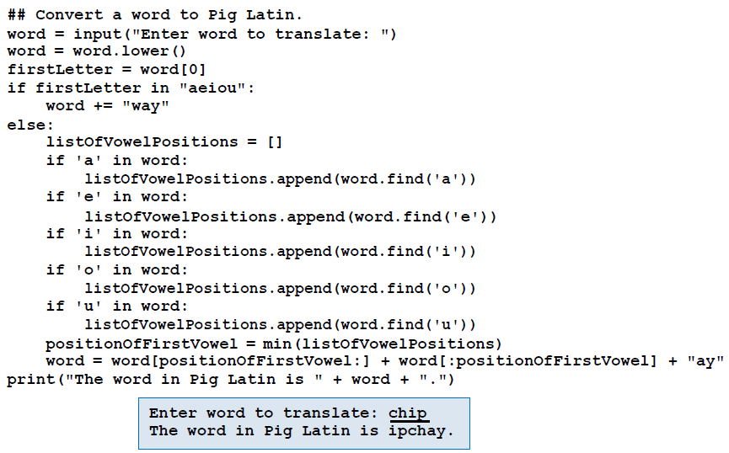

Slide 4
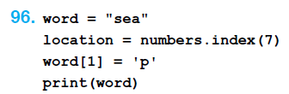



Slide 5
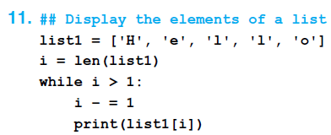
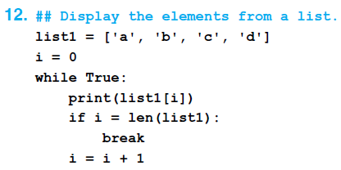

Slide 6
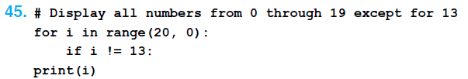
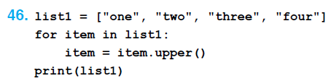

Slide 7
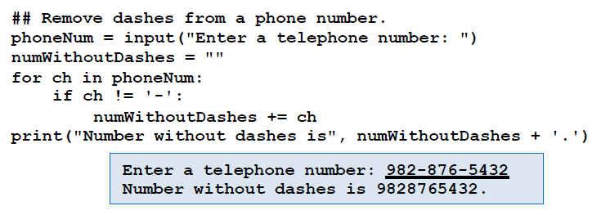

Slide 8
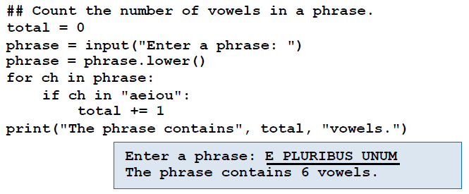

Slide 9

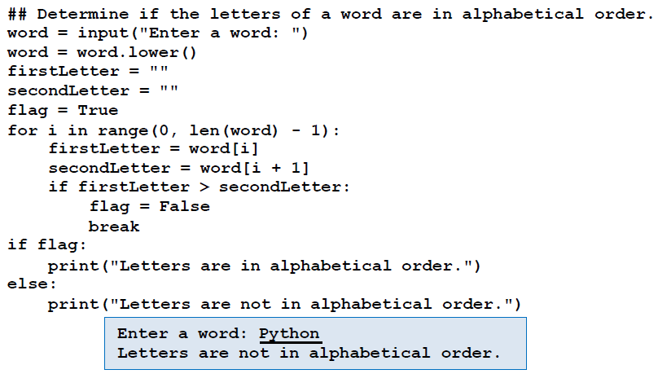

Slide 10
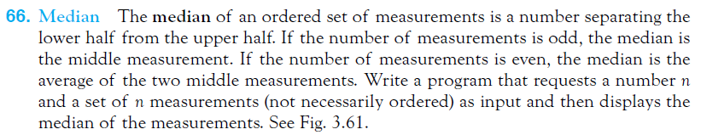
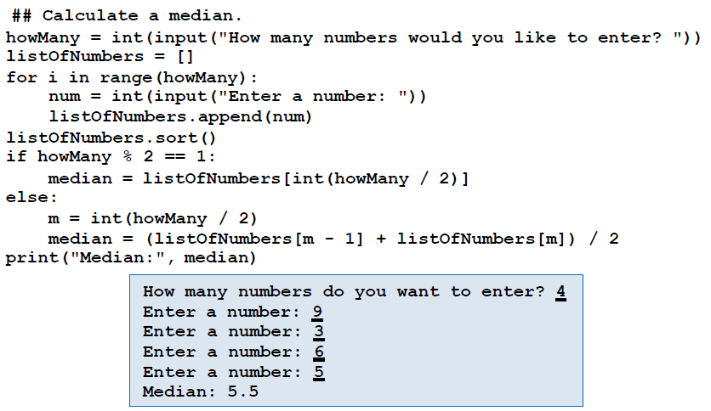

Slide 11
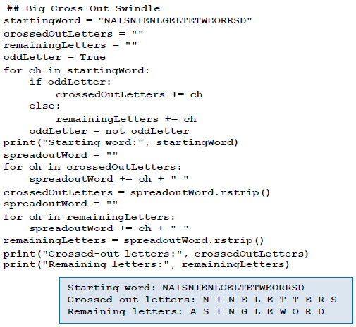
A Puzzle The following puzzle is known as The Big Cross-Out Swindle. “Beginning with the word ‘NAISNIENLGELTETWEORRSD,’ cross out nine letters in such a way that the remaining letters spell “a single word“. Write a program that creates variables named startingWord, crossedOutLetters, and remainingLetters. The program should assign to startingWord the string given in the puzzle, assign to crossedOutLetters a list containing every other letter of startingWord beginning with the initial letter N, and assign to remainingLetters a list containing every other letter of startingWord beginning with the second letter, A. The program should then display the values of the three variables.

Slide 12

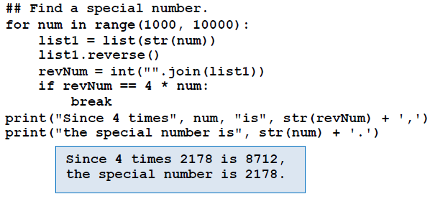

Slide 13
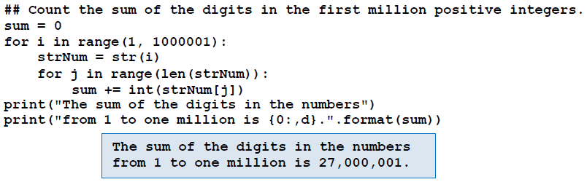

Slide 14
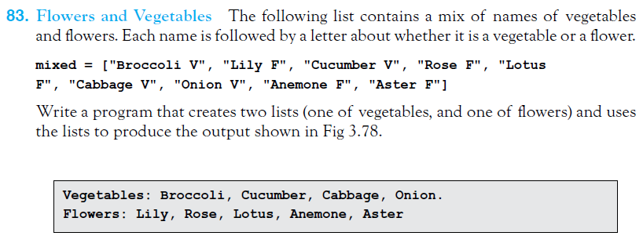
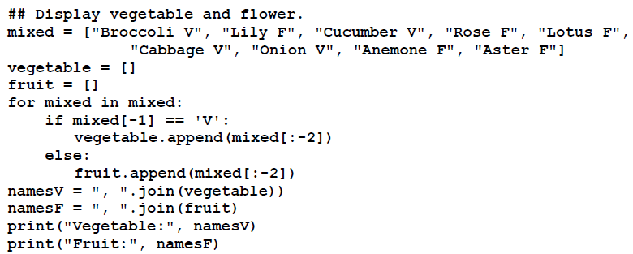

Slide 15
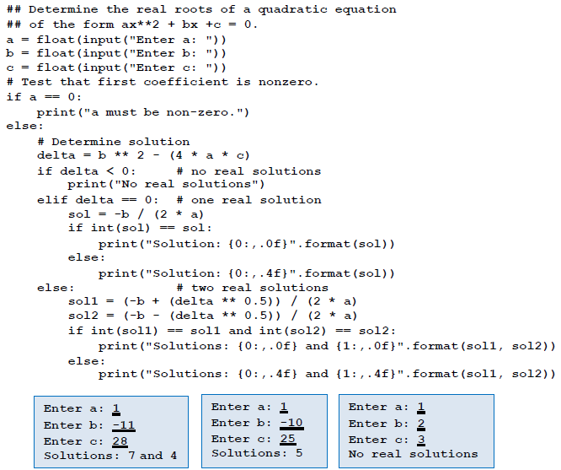
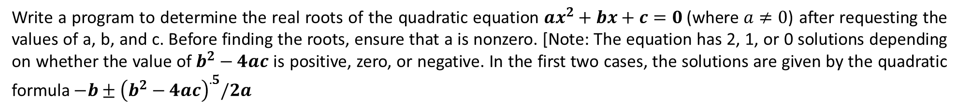
Write a program to determine the real roots of the quadratic equation $ax^{2}+bx+c=0$(where $a≠0$) after requesting the values of a, b, and c. Before finding the roots, ensure that a is nonzero. [Note: The equation has 2, 1, or 0 solutions depending on whether the value of $b^{2}−4ac$ is positive, zero, or negative. In the first two cases, the solutions are given by the quadratic formula $−b±{\left(b^{2}−4ac\right)}^{.5}/2a$

Slide 16
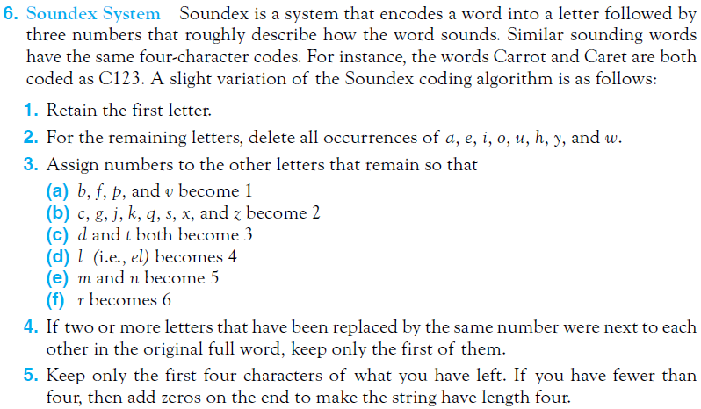
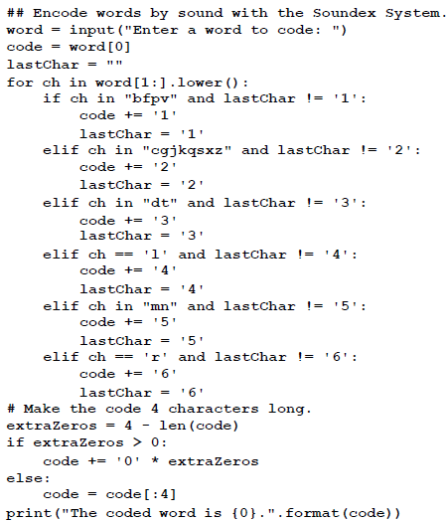


Slide 17
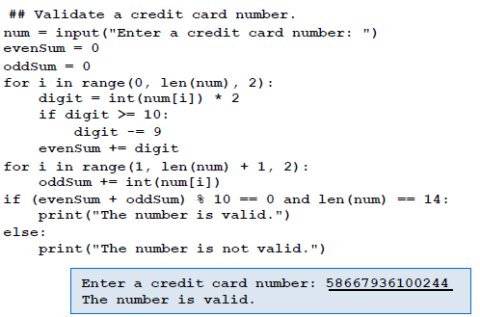
Suppose you type a 14-digit credit card number into a Web site, but mistype one of the digits or interchange two adjacent digits. The Web site will perform a validation check that always detects the first type of error and nearly always detects the second type of error. The validation check is as follows:
1. Starting with the leftmost digit, double it and then double every other digit after it. However, if any of the doubled digits is a two-digit number, subtract 9 from it. Then sum these new digits. For instance, if the credit card number is 58667936100244,
then the digits considered are 5, 6, 7, 3, 1, 0, 4, their new replacements are 1, 3, 5, 6, 2, 0, 8, and the sum of the replacements is 25.
2. Sum together the remaining seven digits from the credit card number. That is, the digits in the odd-numbered positions. With the credit card number above, we obtain 8 + 6 + 9 + 6 + 0 + 2 + 4 = 35.
3. Add together the two sums. If the result is a multiple of 10, then accept the credit card number. Otherwise, reject it. We accept the credit card number above since 25 + 35 = 60, a multiple of 10. Write a program of data validation on a credit card.

Slide 18
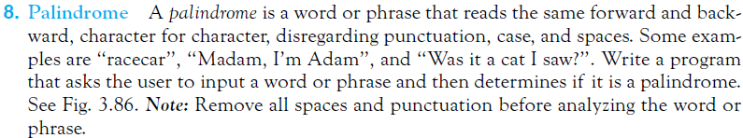
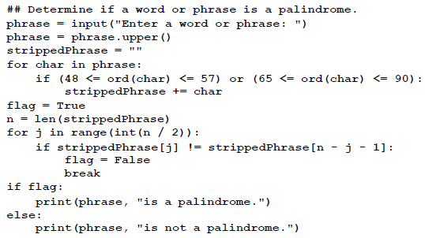
madam
j
n-j-1

Slide 19
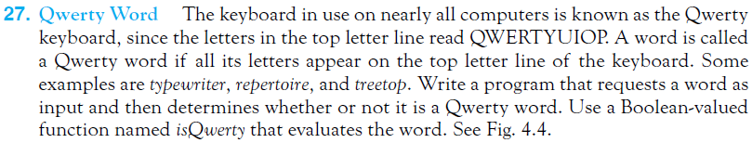
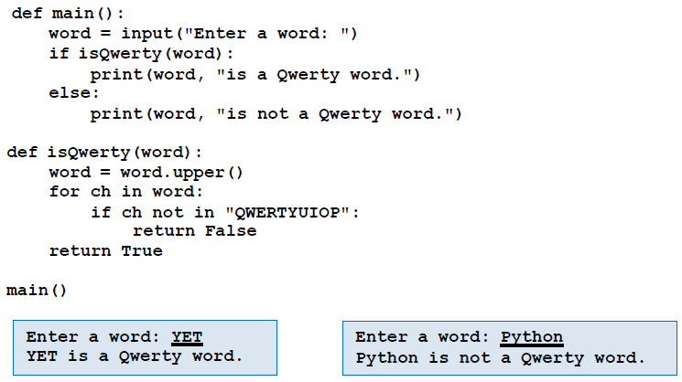

Slide 20
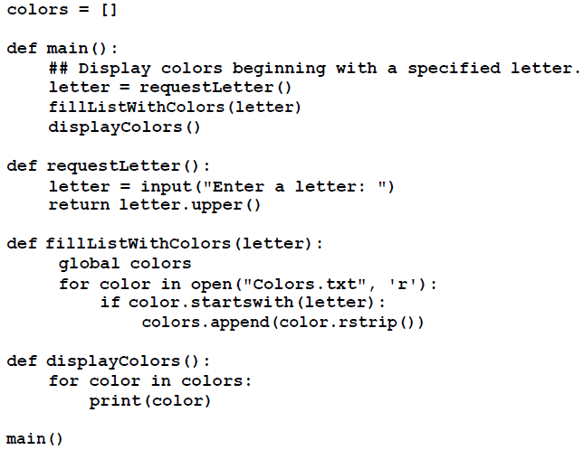
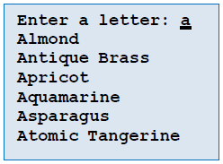
The file Colors.txt contains the names (beginning with uppercase letters) of 123 crayon colors with one color per line. Write a program that requests a letter of the alphabet as input and then displays the colors beginning with that letter. The program should use a global variable colors that is initialized as an empty list. The function main should call three functions, one to request the initial letter, one to fill the list colors with the colors having the requested initial letter, and one to display the names of the colors in the list.

Slide 21
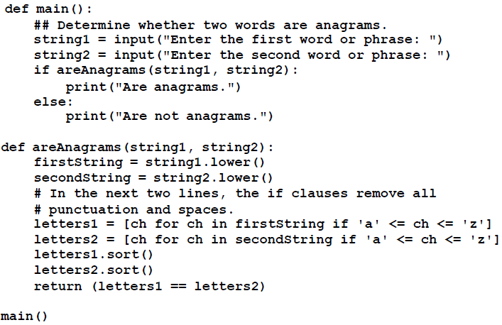

An anagram of a word or phrase is another word or phrase that uses the same letters with the same frequency. Punctuation marks, case, and spaces are ignored. Some examples of anagram pairs are “angered”/“enraged” and “A gentleman”/“Elegant
man”. Write a program that requests two words or phrases as input and determines if they are anagrams of each other. The program should use a Boolean-valued function with header
def areAnagrams(string1, string2):
that returns True when the two strings are anagrams, and otherwise returns False.

Slide 22
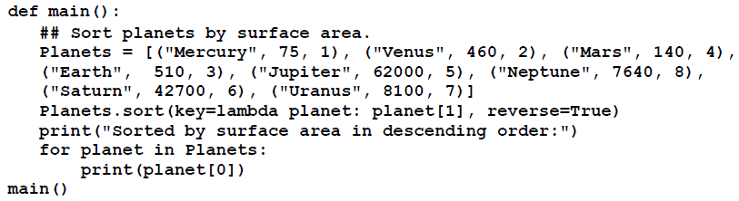


Slide 23
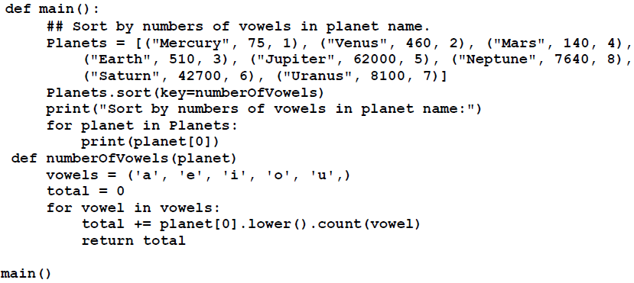


Slide 24
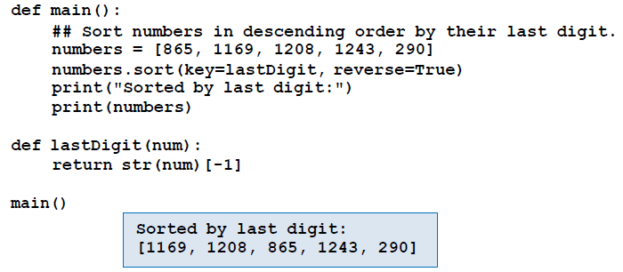

Slide 25
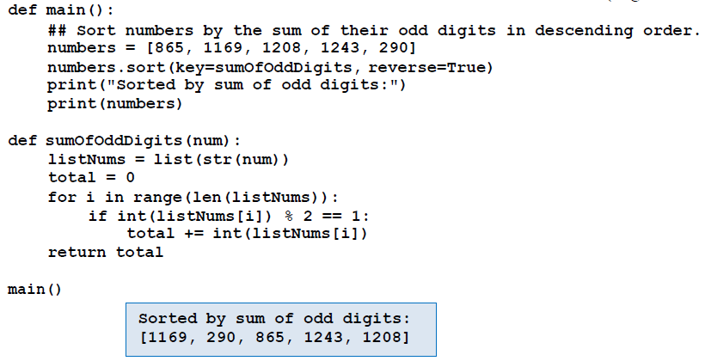

Slide 26
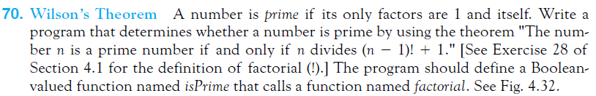
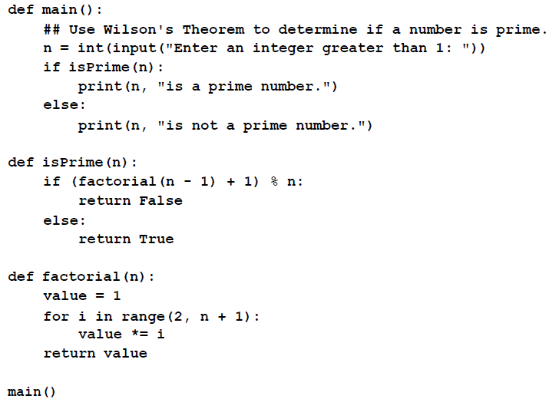


Slide 27
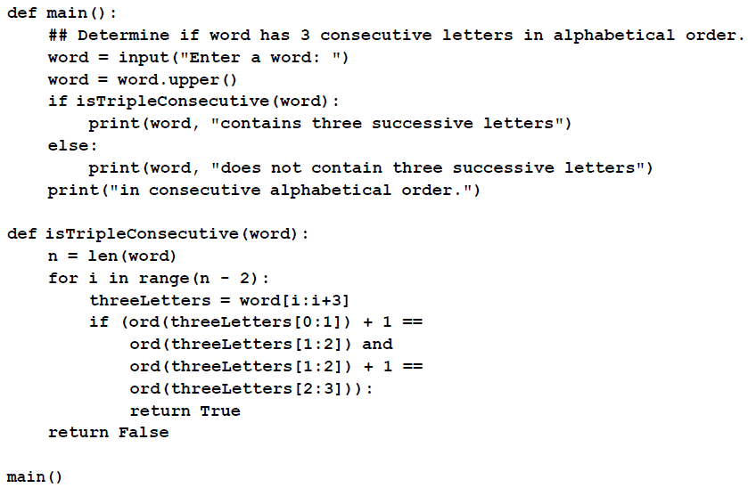

The following words have three consecutive letters that are also consecutive letters in the alphabet: THIRSTY, NOPE, AFGHANISTAN, STUDENT. Write a program that accepts a word as input and determines whether or not it has three consecutive letters that are consecutive letters in the alphabet. The program should use a Boolean-valued function named isTripleConsecutive that accepts an entire word as input. Hint: Use the ord function.

